Slide 1
Credit Card Fraud Detection using Gradient Boosting Classifier and AdaBoost
Prepared by: Prashant Kumar
Department: Computer Science & Engineering

Slide 2
Introduction
Rapid growth of online and card-based transactions has increased fraud risks
Credit card fraud leads to major financial losses and trust issues
Traditional rule-based systems are inefficient for modern fraud patterns
Machine learning enables automated, accurate, and scalable fraud detection
Objective:
To detect fraudulent transactions using ensemble learning techniques.

Slide 3
Problem Statement
Fraud detection is a binary classification problem
Transactions are classified as:
Legitimate (0)
Fraudulent (1)
Key challenges:
Highly imbalanced dataset
Complex and hidden fraud patterns
Need for high recall to detect rare fraud cases

Slide 4
Dataset Description
Dataset contains real-world credit card transactions
Features:
  Numerical transaction attributes
  Anonymized for privacy protection
Target column:
  Class = 0 → Normal transaction
  Class = 1 → Fraudulent transaction
Important Observation:
Fraudulent transactions are very rare compared to normal transactions.

Slide 5
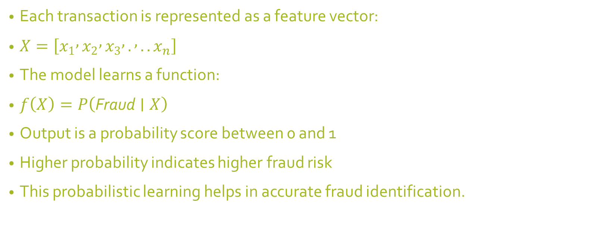
Mathematical Intuition
Each transaction is represented as a feature vector:
$X=\left[x_{1} , x_{2} , x_{3} , . , ..x_{n}\right]$
The model learns a function:
$f\left(X\right)=P\left(\text{Fraud}∣X\right)$
Output is a probability score between 0 and 1
Higher probability indicates higher fraud risk
This probabilistic learning helps in accurate fraud identification.

Slide 6
Gradient Boosting Classifier
Ensemble learning technique based on decision trees
Trees are built sequentially
Each new tree corrects errors made by previous trees
Optimizes a loss function (log loss) to improve predictions
Advantages:
High accuracy
Handles complex non-linear patterns
Strong performance on structured data

Slide 7
AdaBoost Classifier
Adaptive Boosting algorithm
Focuses more on misclassified data points
Assigns higher weights to difficult transactions
Combines multiple weak learners into a strong model
Advantages:
Simple and efficient
Improves classification of rare fraud cases
Reduces bias in predictions

Slide 8
Model Training & Evaluation
Dataset split into training and testing sets
Models trained:
  Gradient Boosting Classifier
  AdaBoost Classifier
Evaluation metrics:
  Precision
  Recall
  F1-score
  ROC–AUC
Reason:
Accuracy alone is not sufficient for imbalanced fraud datasets.

Slide 9
Results & Comparison
Gradient Boosting:
  High overall accuracy
  Strong fraud detection capability
AdaBoost:
  Better focus on misclassified fraud cases
  Improved recall for minority class
Both models effectively detect fraudulent transactions.

Slide 10
Conclusion & Future Scope
Conclusion:
Ensemble learning methods are effective for fraud detection
Gradient Boosting and AdaBoost complement each other
System can be applied to real banking environments
Future Scope:
Real-time fraud detection
Integration with banking APIs
Use of deep learning and explainable AI

